Slide 1
Principles of Extreme Programming
Jay Smith
Microsoft ASP .NET MVP
PMO Architect and Evangelist
Tyson Foods, Inc.

Slide 2
Agenda
Introduction
Whole Team
Planning Game
Customer Tests
Simple Design
Pair Programming
Test Driven Development
Design Improvement
Collective Ownership
Continuous Integration

Slide 3
Whole Team
All the contributions to an XP project, business analyst, testers, etc., work together in an open space, members of one team. The walls of this space is littered with big visible charts and other evidence of their progress.

Slide 4
Planning Game
Planning is continuous and progressive. Every two weeks, for the next two weeks, developers estimate the cost of the candidate features, and customers select those features to be implemented upon cost and business values.

Slide 5
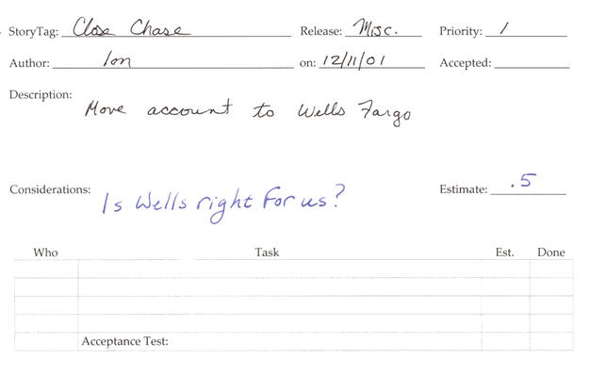
User Stories

Slide 6
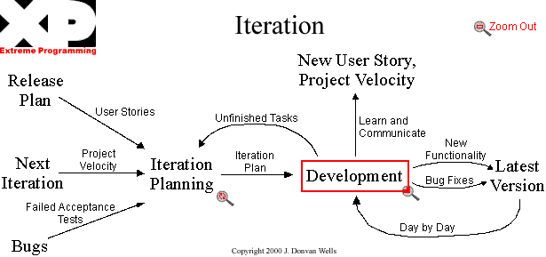
The Planning Game

Slide 7
Customer Tests
As part of selecting each desired feature, the customers define automated acceptance tests to show that the feature is working.

Slide 8
Pair Programming
All production software is built by two programmers, sitting side by side, at the same machine.

Slide 9
Test-Driven Development
The programmers work in very short cycles, adding a failing test, then making it work.
RED
GREEN
REFACTOR

Slide 10
Design Improvement
Don’t let the sun set on bad code. Keep the code as clean and expressive as possible.

Slide 11
Continuous Integration
The team keeps the system fully integrated at all times.

Slide 12
Sustainable Pace
The team is in it for the long term. They work hard, at a pace that can be sustained indefinitely. They conserve their energy, treating the project as a marathon rather than a sprint.

Slide 13
Other
Collective Code Ownership
Any pair of programmers can improve any code at any time.
Coding Standard
All the code in the system looks as if it was written by a single – very competent – individual.
Metaphor
The team develops a common vision of how the program works.

Slide 14
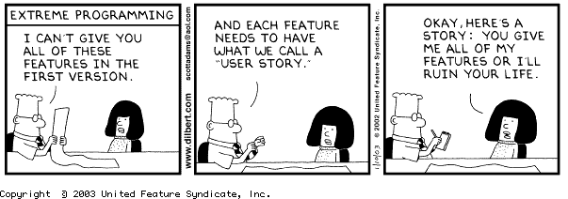
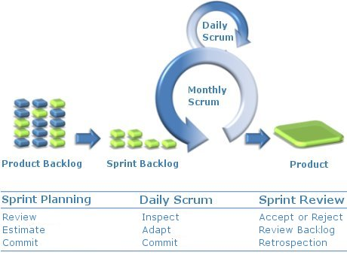
Short Cycles

Slide 15
Summary
Extreme Programming is a set of simple and concrete practices that combine into an agile development process.
XP is a good general-purpose method for developing software.
Many project teams will be able to adopt it as is.
Many others will be able to adapt it by adding or modifying practices.

Slide 16
Resources
Extreme Programming – http://extremeprogramming.org

Slide 17
Contact Info
Jay Smith - jay@jaysmith.us
http://jaysmith.us
Twitter – http://twitter.com/JaySmith
LinkedIn - http://www.linkedin.com/in/jaywsmith
NWA .NET User Group - http://nwadnug.org

